Slide 1
Advanced Algorithms Project
Algorithmic aspect of vertex elimination on graphs
Donald J. Rose - R. Endre Tarjan
Castelli Francesco - 10563276

Slide 2
Abstract
Graph elimination process
Two new algorithms for finding minimal and perfect elimination orders (LEXM and LEXP)
One algorithm for computing the fill-in edges given an ordering (FILL)

Slide 3
Graph elimination process
Sequence of v-elimination graphs G_{v} following the order α of the graph
G_{v} may introduce new edges in the graph
The fill-in set of G ( F(G_{α}) ) is the set of all the edges added during each step of the elimination process
Goal: minimize the fill-in set in order to make the elimination process faster

Slide 4
Graph ordering
Perfect elimination ordering: fill-in set empty
Minimal elimination ordering: no other ordering β satisfies F(G_{β}) C F(G_{α})
If a graph is a perfect elimination graph, any minimal ordering is perfect
LEXM and LEXP do so by using a lexicographic search

Slide 5
Lexicographic search
Vertices numbered from n to 1
Each vertex has an associated label
Label is a set of numbers from 1 to n, organized in decreasing order
We can define precedences between labels

Slide 6
LEXM
Find a minimal ordering for any graph
Assign the empty label to all the nodes
For i=n step -1 until 1
Select an unnumbered vertex with largest label
Assign to v the order i
Update

Slide 7
LEXM Update
Finds all the vertices w connected with v through chains with these properties:
All the vertices on the chain are unnumbered
All the vertices on the chain have a label which is less than the label of w
Add the order i to the labels of all the w
Necessary condition because we are trying to find minimal orderings, and so fill-in edges may be present

Slide 8
LEXM Implementation
Associate to each vertex an integer number ( label )
Labels are between 1 and k, where k is the number of distinct labels
Unnumbered vertices are kept in labels order, so we can alway take the one with highest label
First search though the adjacent set of v, then extend the search and increase label value
Sort the unnumbered vertices by labels and re-define k

Slide 9
LEXM Analysis
Search is bounded by the number of edges (e) and is repeated for every node (n):
Time complexity: O( n*e )
Space complexity: O( n + e )

Slide 10
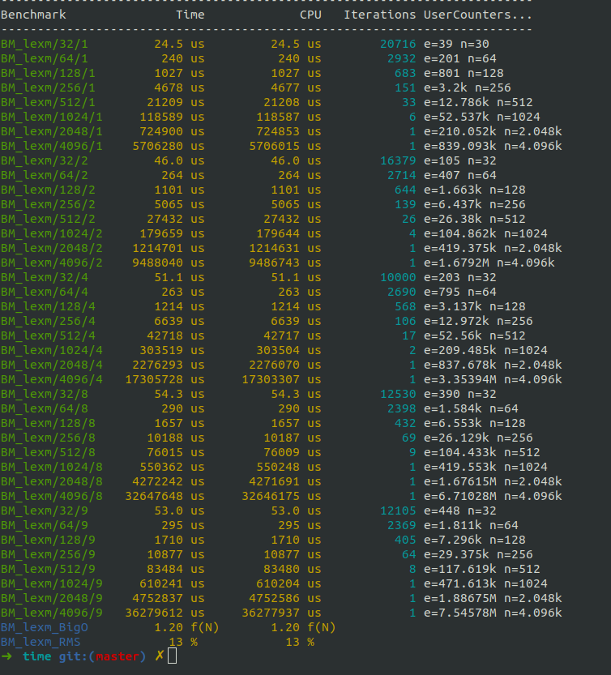
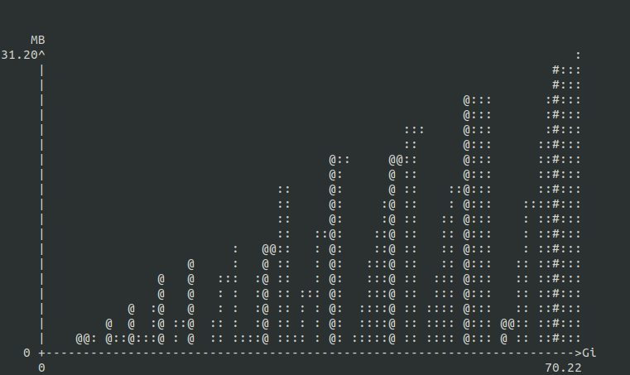
LEXM Benchmark results
n=50
e=74
n=500
e=62260
n=1000
e=428294
LEXM run multiple times over graphs with n and e increasing both with a constant factor
Space complexity: linear in n+e
Time complexity: 1.20 * f(N), where N is n*e
RMS: 13%

Slide 11
LEXP
Generate a perfect ordering for a graph G, if G has any perfect ordering
Assign the empty label to all the nodes
For i=n step -1 until 1
Select an unnumbered vertex with largest label
Assign to v the order i
Update2

Slide 12
LEXP Update2
Perfect elimination graph, the fill-in set is empty
Lemma 6, pag 18: the label of a vertex can simply be found from its monotonely adjacent set
Update is simpler:
For each unnumbered vertex w adjacent to v, add the order of v to label of w

Slide 13
LEXP Implementation
Based on a particular data structure: List of sets where each set is a label
Assign vertices to labels
Labels are kept in lexicographic order from highest to lowest
When a new node is numbered we move all the adjacent nodes to a new set

Slide 14
LEXP Analysis
Iterates over all the nodes (n) and for each node goes through the adjacent list of it. This means that in total goes through all the edges (e):
Time complexity: O( n+e )
The number of nodes in the data structure is the number of labels, and we can add a new label every time we iterate an adjacent list:
Space complexity: O( n+e )

Slide 15
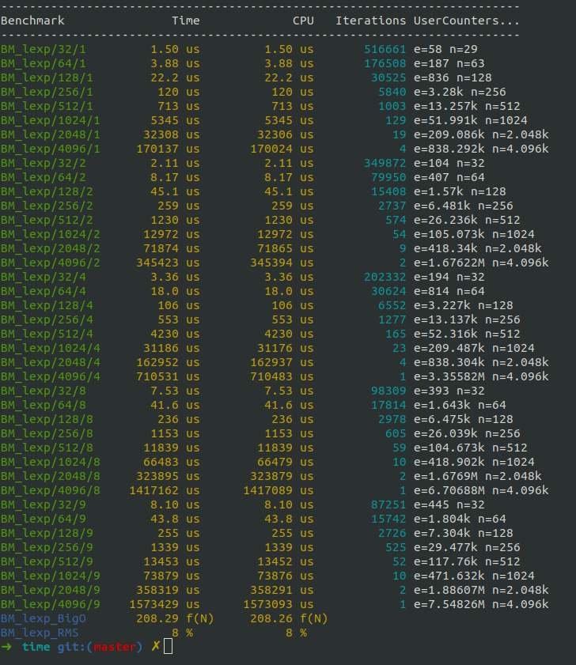
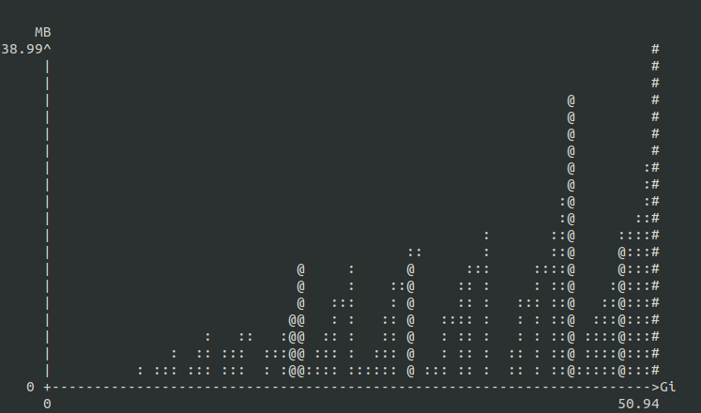
LEXP Benchmark results
n=50
e=68
n=500
e=62400
n=1000
e=428509
LEXP run multiple times over graphs with n and e increasing both with a constant factor
Space complexity: linear in n+e
Time complexity: 208.29 * f(N), where N is n+e
RMS: 8%

Slide 16
FILL
Compute the fill-in set of an ordered graph
For i = 1 step 1 until n-1:
Select the current vertex v based on the order
Selected the vertex m(v) with the minimum order among the monotonely adjacent set of v
For all w that are monotonely adjacent to v and different from m(v):
Add w to the adjacent set of m(v)
We need to ensure that every time statement add is executed, the adjacent list of v is free of redundancies

Slide 17
FILL
Lemma 4, pag 11:
In G*, v->- w implies m(v) = w or m(v) ->- w
where m(v) is the vertex with minimum order among the ones monotonely adjacent to v

Slide 18
FILL Analysis
Number of nodes added is limited by the size of the adjacent set (no duplicates)
Total number of additions is bounded by total number of edges in the final graph (e’):
Time complexity: O( n+e’ )
Space complexity: O( n+e’ )

Slide 19
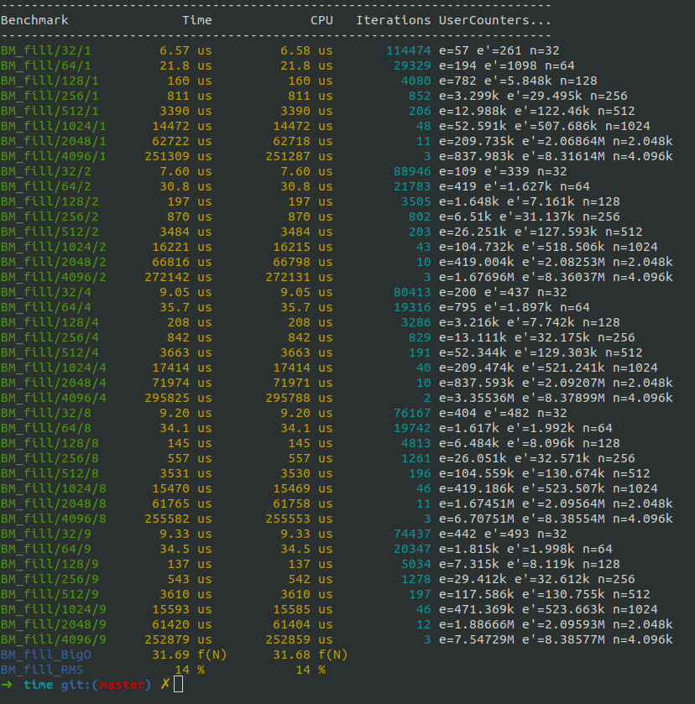
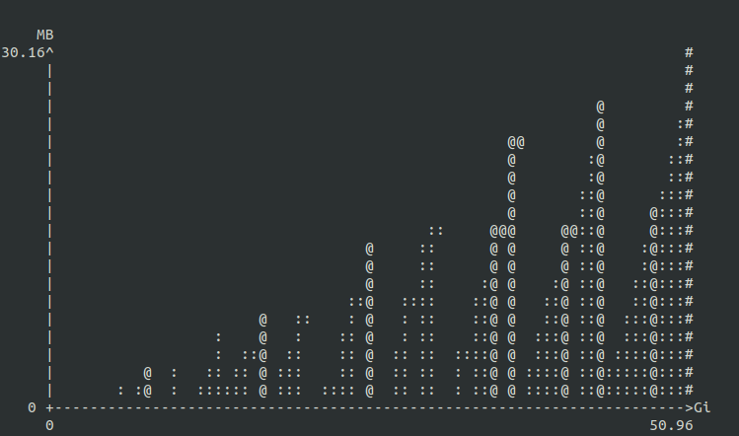
Benchmark results
n=50
e’=316
n=500
e’=123543
n=1000
e’=450733
FILL run multiple times over graphs with n and e’ increasing both with a constant factor
Space complexity: linear in n+e’
Time complexity: 31.69 * f(N), where N is n+e’
RMS: 14%

Slide 20
Code and references
https://github.com/francescocastelli/aa-project
Benchmarks: Google benchmarks and Valgrind
Tests: Google tests
Graph: My implementation
Random graph generation: Erdős–Rényi model - Wikipedia , second model

